Slide 1
AdaptiCon: Phonetic adaptation in the context of Cantonese tone merging
Notes:
Ivan:
Our project is named adapticon, and our project is to investigate if we can reverse a tone merger over time through a conversation task

Slide 2
Theoretical Account
Notes:
Ivan

Slide 3
What is Phonetic Adaptation? a.k.a. phonetic/conversational accommodation, speech alignment, entrainment, convergence, resonance
Adjustment of pronunciation:
Non-conscious, spontaneous^{1,2,3}
For effective communication^{1,2,3}
Acoustic characteristics¹
speech rate
vowel intensity
vowel spectra
Influenced by social dynamics¹
[1] Dias & Rosenblum, 2016; [2] Lewandowski & Jilka, 2019; [3] Lin et al., 2021
Notes:
Sam:
A phenomenon with many names. It happens spontaneously for the purposes of effective communication. Phonetic adaptation manifests in acoustic characteristics and can be infuenced by social dynamics.
Non-conscious, spontaneous phenomenon of adjusting one's pronunciation when verbally while interacting with an interlocutor in order to enhance communicative effectiveness
Manifests in acoustic characteristics
Social dynamics able to influence the degree of convergence

Slide 4
Sociological Account
Communication Accommodation Theory (Andreeva et al. 2021, Bradshaw and McGettigan 2021):
Adaptation affected by:
Belief of speaker’s nativeness (Jiang & Kennison 2021)
Role status (Andreeva et al. 2021)
Agreement on ideas (Andreeva et al. 2021
Personality and cognitive measures (Lewandowski & Jilka 2019).
Notes:
Sam:
A phenomenon with many names. It happens spontaneously for the purposes of effective communication. Phonetic adaptation manifests in acoustic characteristics and can be infuenced by social dynamics.
Non-conscious, spontaneous phenomenon of adjusting one's pronunciation when verbally while interacting with an interlocutor in order to enhance communicative effectiveness
Manifests in acoustic characteristics
Social dynamics able to influence the degree of convergence

Slide 5
Phonetic Account
Hyper- and hypo-articulation (H&H) Theory (Lindblom 1990)
Speaker aware of the listener’s need or lack thereof need for adjustment of speech:
Hyper-articulated speech - future and output-oriented process (e.g. trying to articulate a target sound accurately);
Hypo-articulated speech - movement-economical, system-oriented process (e.g. trying to hit the target sound with minimal effort).
Notes:
Sam:
A phenomenon with many names. It happens spontaneously for the purposes of effective communication. Phonetic adaptation manifests in acoustic characteristics and can be infuenced by social dynamics.
Non-conscious, spontaneous phenomenon of adjusting one's pronunciation when verbally while interacting with an interlocutor in order to enhance communicative effectiveness
Manifests in acoustic characteristics
Social dynamics able to influence the degree of convergence

Slide 6
Phonetic Account
H&H Theory cont. (Lindblom 1990)
To the listener:
Not the signal itself
The ability to lexically discriminate spoken items
Signal-complementary process that is knowledge driven
(e.g. knowing that the word “dogs” will come after the phrase “it’s raining cats and ____”).
Notes:
Sam:
A phenomenon with many names. It happens spontaneously for the purposes of effective communication. Phonetic adaptation manifests in acoustic characteristics and can be infuenced by social dynamics.
Non-conscious, spontaneous phenomenon of adjusting one's pronunciation when verbally while interacting with an interlocutor in order to enhance communicative effectiveness
Manifests in acoustic characteristics
Social dynamics able to influence the degree of convergence

Slide 7
Phonetic Account
Exemplar Theory (Lin et al. 2021, Pardo et al. 2017):
All instances of exposure to a word would leave traces, forming a “cloud” of tokens
Averaged out in subsequent perception and production
Interactive Alignment Theory (IAT) (Jiang & Kennison 2022, Lin et al. 2021):
The listener align their language with the speaker at multiple linguistic levels to reach a “common ground”
Prediction-by-association (thunder after lightning)
Prediction-by-simulation. (covert imitation)
Notes:
Sam:
A phenomenon with many names. It happens spontaneously for the purposes of effective communication. Phonetic adaptation manifests in acoustic characteristics and can be infuenced by social dynamics.
Non-conscious, spontaneous phenomenon of adjusting one's pronunciation when verbally while interacting with an interlocutor in order to enhance communicative effectiveness
Manifests in acoustic characteristics
Social dynamics able to influence the degree of convergence

Slide 8
Phonetic Account
The Dynamical Systems Theory (Bradshaw & McGettigan 2021, Pardo 2006)
Mechanics behind adaptation
Interlocutors act as a coupled dynamical system
Dominant speaker, with externally derived information (e.g. voice), would create a “magnet force”
Pull the less dominant speaker’s internal coordination.
E.g. entrainment process of people who stutter by producing synchronist speech with an accompanist.
Notes:
Sam:
A phenomenon with many names. It happens spontaneously for the purposes of effective communication. Phonetic adaptation manifests in acoustic characteristics and can be infuenced by social dynamics.
Non-conscious, spontaneous phenomenon of adjusting one's pronunciation when verbally while interacting with an interlocutor in order to enhance communicative effectiveness
Manifests in acoustic characteristics
Social dynamics able to influence the degree of convergence

Slide 9
Phonetic Account
The Interpersonal Synergy framework (Fusaroli et al., 2014; Olmstead et al., 2021)
Through functionally specific, reciprocated, and compressed dimensional effort, two interlocutors will synergise to reach a common motor goal in speech.
Phonetic synergy - Adaptation is the result of:
Cascading, co-constraining changes in both perception and production,
Serve the fundamental goals of joint action.
Notes:
Sam:
A phenomenon with many names. It happens spontaneously for the purposes of effective communication. Phonetic adaptation manifests in acoustic characteristics and can be infuenced by social dynamics.
Non-conscious, spontaneous phenomenon of adjusting one's pronunciation when verbally while interacting with an interlocutor in order to enhance communicative effectiveness
Manifests in acoustic characteristics
Social dynamics able to influence the degree of convergence

Slide 10
Phonetic Account
The Interpersonal Synergy framework cont. (Fusaroli et al., 2014; Olmstead et al., 2021)
Three principles of phonetic synergy:
Same phonetic problem can be solved by variable, functionally specific solutions available to the dyads’ perception and production system
Instead of mimicry, the synergy between the dyads are more like reciprocal compensation, resulting in complementary phonetic shift
The synergy and stability of the dyad systems can only be evaluated at the higher level of the dyads themselves instead of the individuality of each dyad as there is co-constraining influences of the interlocutors.
Notes:
Sam:
A phenomenon with many names. It happens spontaneously for the purposes of effective communication. Phonetic adaptation manifests in acoustic characteristics and can be infuenced by social dynamics.
Non-conscious, spontaneous phenomenon of adjusting one's pronunciation when verbally while interacting with an interlocutor in order to enhance communicative effectiveness
Manifests in acoustic characteristics
Social dynamics able to influence the degree of convergence

Slide 11
Phonetic Account
Adaptation is a reciprocated process involving both perception and production:
Listener:
Although the output is determined by the speaker, the process also shaped by the perceiver’s cognition.
Speaker:
Inevitable feedback loop of listeners using perceived signals for future production,
Notes:
Sam:
A phenomenon with many names. It happens spontaneously for the purposes of effective communication. Phonetic adaptation manifests in acoustic characteristics and can be infuenced by social dynamics.
Non-conscious, spontaneous phenomenon of adjusting one's pronunciation when verbally while interacting with an interlocutor in order to enhance communicative effectiveness
Manifests in acoustic characteristics
Social dynamics able to influence the degree of convergence

Slide 12
Phonetic Account
Ultimately, all theories point to a both conscious and non-conscious effort between interlocutors to reach a common ground during conversations. As much as the specifics can be pointed at either the speaker or the perceiver, analysis on both dyads are needed to truly evaluate adaptation.
Notes:
Sam:
A phenomenon with many names. It happens spontaneously for the purposes of effective communication. Phonetic adaptation manifests in acoustic characteristics and can be infuenced by social dynamics.
Non-conscious, spontaneous phenomenon of adjusting one's pronunciation when verbally while interacting with an interlocutor in order to enhance communicative effectiveness
Manifests in acoustic characteristics
Social dynamics able to influence the degree of convergence

Slide 13
What is Phonetic Adaptation? (cont’d)
In particular:
Lin et al. (2021)
Reversing a Cantonese tone-merger through shadowing
As such…
Notes:
Sam:
Of particular relevance to us, Lin et al. (2021) investigated whether speakers will reverse a Cantonese tone-merger-in-progress through a shadowing task, as such…

Slide 14
We will be using tone-mergers in Cantonese as a means of investigating phonetic adaptation But before we elaborate…
Notes:
Sam

Slide 15
Research Question: Does phonetic adaptation happen in a conversational task in which Cantonese T3/T6 mergers will unmerge the pair of tones when interacting with those that do not merge the pair?
Notes:
Ivan

Slide 16
Cantonese Tone-Merger
Fan3
Fan6?
Notes:
Sam: What is a Cantonese tone-merger?

Slide 17
What is Cantonese Tone Merger?
Pairs within 6 lexically contrastive tones that are being merged in production and/or perception
Fung & Lee, 2019
T2/T5 - Full merger
T3/T6 - Partial Merger
T4/T6 - Near Merger
Fung & Lee, 2019
Notes:
Ivan:
There are six lexically contrastive tones in Cantonese, and I will produce all of them once now. And some pairs are currently experiencing merging.
An example of merger, although not in tone, in English would be the merging of perception and production in the cot-caught vowels, so the name Don and Dawn would sound the same to certain dialects of English.
High-rising and low-rising tone (T2/T5) - Full merger on Production and Perception
Mid-level and low-level tone (T3/T6) - Partial Merger on Production only
Low-falling and low-level tone (T4/T6) - Near Merger on Perception only

Slide 18
Fung & Lee, 2010
Notes:
Ivan:
Once again, this is a chart of the tones produced by an unmerged speaker

Slide 19
Fung & Lee, 2010
Notes:
Ivan:
And this is a hypothetical chart were a merger have two pairs of tones merged, effectively yielding only 4 contrastive tones.

Slide 20
Adaptation on tones
Recall from Lin et al. (2021):
Reverse a Cantonese tone-merger through shadowing
Investigated T3/T6
The pair unmerged
Notes:
Ivan: Recall, prevous study investigates whether speakers will reverse a Cantonese tone-merger-in-progress through a shadowing task
T3/T6 minimal pairs for T3/T6 merger investigation
The pair did get unmerged by shadowers

Slide 21
Adaptation on tones (cont’d)
Previous research in the context of Cantonese tone merger:
Controlled, less natural tasks (shadowing)
Imbalance in power/social dynamics
Map task (Pardo, 2006)
Notes:
Ivan:
Previous research on phonetic adaptations had limitations such as:
Controlled, less natural tasks (shadowing)
Imbalance power/social dynamics between two interlocutors
Direction giver vs receiver in map task (Pardo, 2006)
Only on T3/T6 pair for tone-merger

Slide 22
Adaptation on tones (cont’d)
Our study aims at investigating:
More natural setting
Equal grounds
More pairs of tones
Why use tone merger?
Elicit adaptation
Adaptations of tones in natural conversations
Notes:
Ivan:
Our study aims at investigating:
Phonetic adaptation in a more natural setting
Two interlocutors are on equal grounds
More pairs of merged/merging tones in Cantonese
Why use tone merger?
Previously studied to help elicit adaptation
No study done on adaptation of tones in natural conversations

Slide 23
Research Question: Does phonetic adaptation happen in a conversational task in which Cantonese T3/T6 mergers will unmerge the pair of tones when interacting with those that do not merge the pair?
Notes:
Ivan

Slide 24
Main Hypothesis
By combining the findings from Pardo (2006) and Lin et al (2021), we hypothesise that phonetic adaptation will happen in a conversational task through the lens of unmerging the T3/T6 tone pair in Cantonese.
Notes:
Sam

Slide 25
Sub-Hypotheses: Tone Adaptation
To the extent of whether adaptation will happen with tones:
Convergence of tones:
Based on Levitan and Hirschberg (2011) on adaptation of pitch, we suspect that two interlocutors' pitch range for tones might converge to something more similar.
Divergence of tones:
Based on Lin et al (2021) on adaptation of tones, we suspect that speakers with with less tonal distinction would diverge their tones more i.e., tones would become more distinct.
In particular, we suspect those that are exhibiting tone-merging already i.e., T2/T5, T3/T6, T4/T6 (Fung & Lee, 2019; Mok et al., 2013) would exhibit a stronger effect
Notes:
Sam
We also expect pitch range for tones will converge, while tonal distinction will diverge, especially for those who already exhibit a tone merger. In other words, we expect a tone merger reversal

Slide 26
Sub-Hypotheses: Tone Adaptation
By combining the findings from Pardo (2006) and Lin et al (2021):
Phonetic adaptation will happen in a conversational task through the lens of unmerging the T3/T6 tone pair in Cantonese.
Interpreting the results from Cheng (2017) and Li & Guan (2019), we further postulate that younger, female speakers will experience more adaptation.
Notes:
Sam
We also expect pitch range for tones will converge, while tonal distinction will diverge, especially for those who already exhibit a tone merger. In other words, we expect a tone merger reversal

Slide 27
BUT…..Disclaimer
Due to the pilot nature of the experiment and results, we are currently only reporting the results of two participants with focus on one female participant only.
We will also only be describing the tasks that were done so far, not what we envisioned in the future.
Notes:
Ivan: This is only a portion of an ongoing project by Dr Yue Wang’s Language and Brain lab at SFU

Slide 28
Sub-Hypotheses: Reversing a Tone Merger
In the extent of reversing a tone-merger:
Adaptations will be greater in participants with less baseline tonal distinction than in participants with more baseline tonal distinction. (Lin et al., 2021)
Adaptations will be greater if the non-merger speaker of the merger vs non-merger pair is younger (Lin et al.)
Adaptations will be greater in attested merging tone pairs as opposed to distinct tone pairs
The degree of adaptations will be: Full > Partial > Near > Non
Adaptations within speakers at the beginning of the conversation will be less prominent compared to adaptations at the end of the conversation (resulting adaptation)
More instances of adaptation (between speakers) at beginning than at end of conversation
Adaptations will be greater within participants with both visual and audio cues
Adaptations will be greater in words that occur with higher frequency (token or type) (Mok et al., 2013)

Slide 29
Phonetic Adaptation in Natural Conversations
Notes:
Sam: Next, we'll be discussing the details of our task

Slide 30
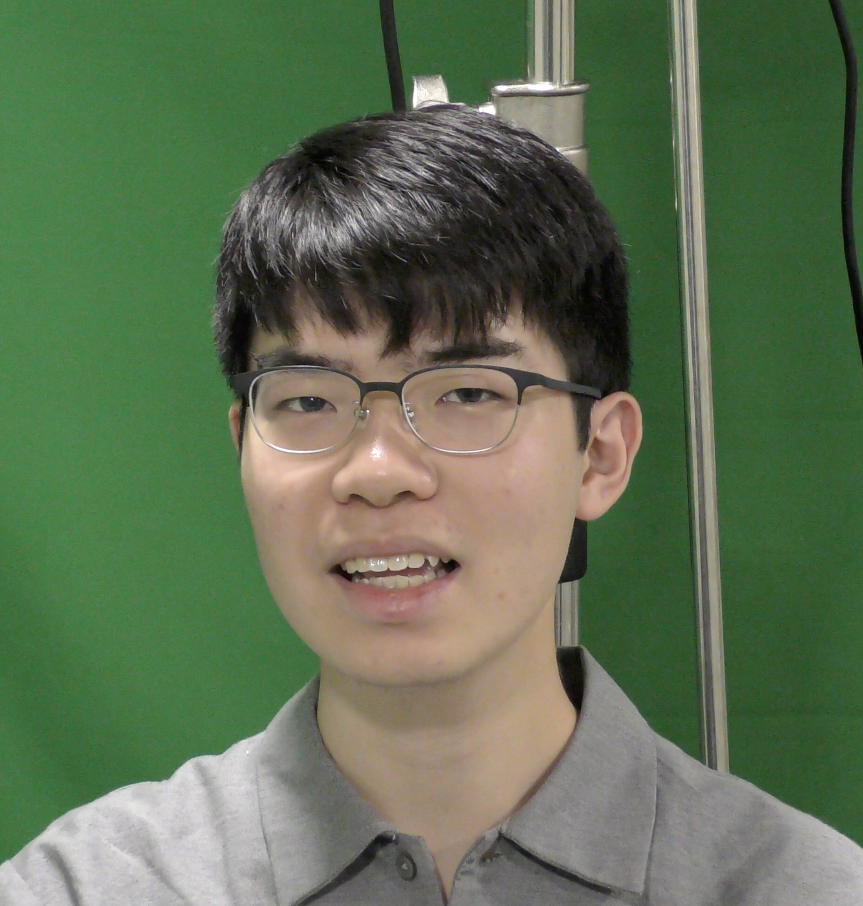
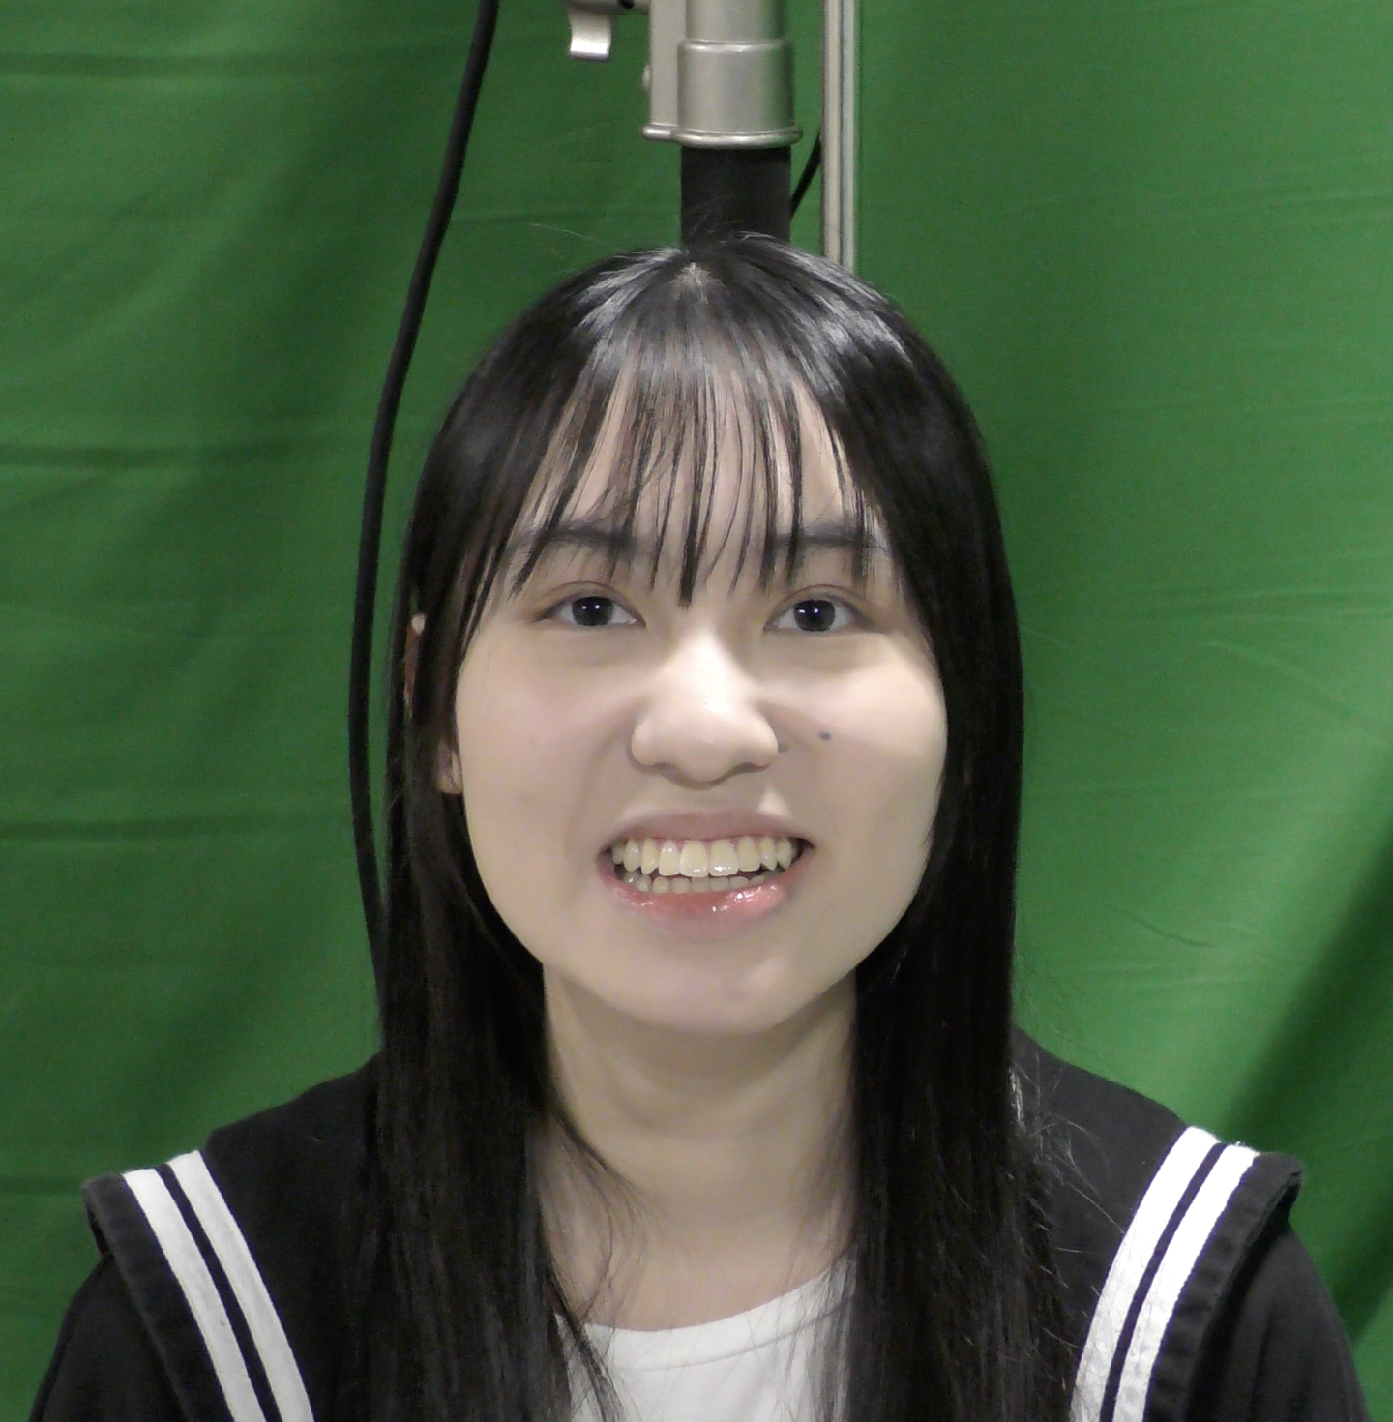
Participant
male confederate aged 20 (M20)
female participant aged 22 (F22)
Both were born and raised in Hong Kong with university education background.
Notes:
Sam
Following procedures of Mok et al. (2013), Fung and Lee (2019), and Soo and Babel (2020).
AX discrimination Task - hearing two sounds, and saying/indicating what it was that you heard
Production Task
Pre-task done online
Allows for pre-determining merger/non-merger participant pair
Pairing will be done using judges who are native Cantonese speakers with unmerged tones

Slide 31
Stimuli
Modifying the stimuli list provided by Lin et al (2021) and Ou (2012),
Character | Jyutping | Gloss | Screening | Baseline & Post-task | Task
報 | bou3 | ‘report’ | + | + | -
部 | bou6 | ‘part’ | + | + | -
帝 | dai3 | ‘emperor’ | + | - | ++GC
弟 | dai6 | ‘younger brother’ | + | - | ++GP
到 | dou3 | ‘arrive’ | - | + | -
度 | dou6 | ‘degree’ | - | + | -
凍 | dung3 | ‘cold’ | - | + | +
洞 | dung6 | ‘cave’ | - | + | +
訓 | fan3 | ‘guidance’ | - | + | -
份 | fan6 | ‘portion’ | - | + | -
富 | fu3 | ‘rich’ | + | - | ++IP
父 | fu6 | ‘father’ | + | - | ++IC
記 | gei3 | ‘record’ | + | + | -
技 | gei6 | ‘skill’ | + | + | -
據 | geoi3 | ‘receipt’ | - | - | +
具 | geoi6 | ‘tool’ | - | - | +
貴 | gwai3 | ‘expensive’ | - | + | ++GC
櫃 | gwai6 | ‘cupboard’ | - | + | ++GP
Character | Jyutping | Gloss | Screening | Baseline & Post-task | Task
印 | jan3 | ‘stamp’ | - | + | +
孕 | jan6 | ‘pregnant’ | - | + | +
幼 | jau3 | ‘infantile’ | + | + | +C
右 | jau6 | ‘right’ | + | + | +P
意 | ji3 | ‘idea’ | - | + | ++IP
二 | ji6 | ‘two’ | - | + | ++IC
怨 | jyun3 | ‘hatred’ | - | + | +P
願 | jyun6 | ‘wish’ | - | + | +C
嗜 | si3 | ‘hobby’ | + | + | -
事 | si6 | ‘event’ | + | + | -
喂 | wai3 | ‘feed’ | + | - | +
胃 | wai6 | ‘stomach’ | + | - | +
最 | zeoi3 | ‘most’ | + | - | ++GC
罪 | zeoi6 | ‘crime’ | + | - | ++GP
至 | zi3 | ‘reach’ | - | + | -
自 | zi6 | ‘self’ | - | + | -
政 | zing3 | ‘government’ | - | - | +
靜 | zing6 | ‘quiet’ | - | - | +
Words highlighted in green will be unpaired in each individual room (C = Confederate, P = Participant), while words with one more “+” sign will have extra mismatched coloured pictures (in G = Green and I = Indigo) on each individual room. Yielding a total of 14 unpairable target words.
Notes:
A total of 18 minimal pairs of Cantonese target words with the same pronunciation except for the tone were produced, yielding 18 words with T3 and another 18 words with T6 respectively. 20 filler words with balanced T3 and T6 tones but no minimal pairs were also produced as distraction items throughout the experiment. All the items used are monosyllabic words, each represented by a traditional Chinese character.

Slide 32
Experiment Task Timeline
e
Screening Task
Baseline Production Task^{1,2,3}
Familiarisation Task
Escape Room Puzzle Tasks
Post-Escape Room Production Task^{1,2,3}
[1] Mok et al., 2013; [2] Fung & Lee, 2019; [3] Soo & Babel, 2020
Notes:
Sam
Following procedures of Mok et al. (2013), Fung and Lee (2019), and Soo and Babel (2020).
AX discrimination Task - hearing two sounds, and saying/indicating what it was that you heard
Production Task
Pre-task done online
Allows for pre-determining merger/non-merger participant pair
Pairing will be done using judges who are native Cantonese speakers with unmerged tones

Slide 33
Pre-Test and Post Test: AX Discrimination Task
Monosyllabic words
Recorded by native Cantonese speaker with contrastive tones
30 syllables (5 morphemes x 6 tones)
105 pairs of syllables [5 morphemes x 21 tone pair contrast (15 AB + 6 AA contrast)]
Participants instructed to indicate “same” or “different”

Slide 34
Pre-Test and Post Test: Lexical Decision Task
Altering procedures of Soo and Babel (2020)
Bi-syllabic words also used
6 contrastive tones produced
Reusing stimuli from AX Discrimination Task
Along with new bi-syllabic items
Yielding 30 new items (5 morphemes x 6 tones)
Participants will click thumbs up or thumbs down button to determine word/non-word

Slide 35
Pre-Test and Post Test: Production Task
Follow the procedures of Mok et al. (2013) and Fung and Lee (2019)
Combining word lists from AX Discrimination Task and Lexical Decision Task
60 (or more) stimuli embedded in carrier phrase:
/ngo2 duk6 ___ zi6/
/ngo2 duk6 ___ __/
Stimuli presented orthographically
Participants will be asked to repeat stimuli twice
Yielding 120 (or more) tokens.

Slide 36
Baseline Production Task
Participant is asked to read through the power point slide, with each slide containing the a word in a carrier phrase “我讀__字” (jyutping: ngo2 duk6 __ zi6):
Notes:
Sam: We'll be using an escape room video game called Escape SImulator, with puzzle components that we've been calling the numbers room and matching room.
Next slide
~~Participants work together to escape the rooms, solving puzzles by sharing the information unique to their respective rooms~~

Slide 37
Familiarisation Task
Participant will be shown a power point slide with instructions on how the escape room game works, their objective, and the list of words that will be used during the task:
Notes:
Sam: We'll be using an escape room video game called Escape SImulator, with puzzle components that we've been calling the numbers room and matching room.
Next slide
~~Participants work together to escape the rooms, solving puzzles by sharing the information unique to their respective rooms~~

Slide 38

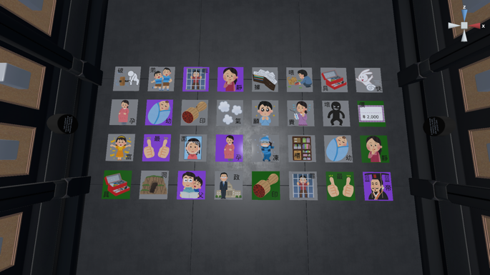
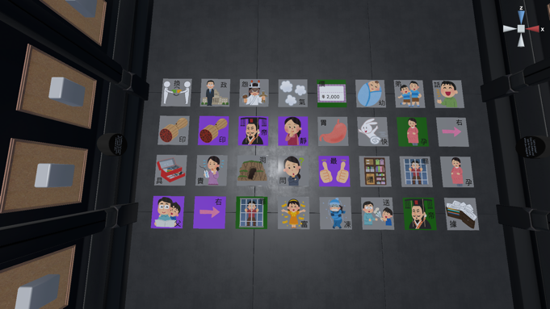
Main Task: Escape Room
Escape room video game (Escape Simulator, Pine Studio, 2021)
Notes:
Sam: We'll be using an escape room video game called Escape SImulator, with puzzle components that we've been calling the numbers room and matching room.
Next slide
~~Participants work together to escape the rooms, solving puzzles by sharing the information unique to their respective rooms~~

Slide 39
Stimuli and Participant
Two types of stimuli:
Stimuli recorded and written for pre/post-task
Stimuli used to promote production of target words in the main task
Participants (Conversation Partners):
Cantonese Merger paired with non-merger

Slide 40
Stimuli List
Level Tones (T1/T3/T6)
煲 pot (T1) vs 報 news/布 cloth (T3)
燈 light (T1) vs 凳 chair (T3)
臂 arm (T3) vs 鼻 nose (T6)
東 east(T1) vs 凍 cold(T3)
龜 turtle/tortoise (T1) vs 櫃 cupboard/wardrobe (T6)
影印【機】printer (T1) vs 日【記】diary (T3)
街 street (T1) vs【戒】指 ring (T3)
雞 chicken (T1) vs 【計】數機 calculator (T3)
錫 kiss (T3) vs 石 stone (T6)
色 colour (T1) vs 【食】物 food (T6)
風 wind (T1) vs 【鳳】凰 phoenix (T6)
【單】車 bicycle (T1) vs 聖【誕】老人 Santa Claus (T3) vs 雞【蛋】仔 bubble waffle (T6)
兜 dish-like container (T1) vs 【豆】腐 tofu (T6)
鬚 beard (T1) vs 【數】學 maths (T3)
Rising Tones (T2/T5)
皮 leather (T2) vs 被 blanket (T5)

Slide 41
Experimental Setting
Conversation partners facing each other, each sitting in front of a monitor.
See Lee et al. (2018) Figure 1
Have a curtain between the participants to change between voice-only and face-to-face modes.
See Dias and Rosenblum (2011) Figure 1
Video camera and mic
Lee et al. (2018), Figure 1
Dias & Rosenblum (2011), Figure 1

Slide 42
Task Description and Procedure
Task Description
Place participants in separate rooms
Two rooms have unique objects or information
Only through collaboration will the puzzles be solved
Adaptation will be elicited/promoted through:
Nature of Tone-Mergers in Cantonese
Merger vs non-merger interactions
Reversibility of a tone-merger
Notes:
Sam: in this task, paticipants will be in separate rooms that have unique information. They'll only be able to solve the puzzles by collaborating. Adaptations will be elicited through merger nonmerger interactions, and through the reversibility of a tone merger
Description of the tasks
Place participants in separate rooms inside video game.
Each of the two rooms have objects or information that are unique to that room specifically.
Participants escape their rooms by sharing information and solving the puzzle presented to them. In this way, only through collaboration will the puzzle be solved.
Adaptation will be elicited/promoted through:
Nature of Tone-Mergers in Cantonese
Merger vs non-merger interactions
Reversibility of a tone-merger as demonstrated by Lin et al previously
The ability to see interlocutor by having screen-off time.

Slide 43
Results and Analysis
A total of 287 tokens from M20 and 178 tokens from F22 were timestamped according to the initial recording, yielding a total of 465 tokens
 | M20 Confederate | F22 Participant
4:20 | 右
4:22 | 右右 | 右*
4:25 |  | 右*右
4:27 | 右右
4:29 | 右
4:30 |  | 帝
4:51 | 右
4:54 | 右
4:55 |  | 右?
4:57 |  | 帝
5:04 | 弟弟 | 右*
Notes:
Sam: in this task, paticipants will be in separate rooms that have unique information. They'll only be able to solve the puzzles by collaborating. Adaptations will be elicited through merger nonmerger interactions, and through the reversibility of a tone merger
Description of the tasks
Place participants in separate rooms inside video game.
Each of the two rooms have objects or information that are unique to that room specifically.
Participants escape their rooms by sharing information and solving the puzzle presented to them. In this way, only through collaboration will the puzzle be solved.
Adaptation will be elicited/promoted through:
Nature of Tone-Mergers in Cantonese
Merger vs non-merger interactions
Reversibility of a tone-merger as demonstrated by Lin et al previously
The ability to see interlocutor by having screen-off time.

Slide 44
Results and Analysis
Only analyse F22’s tokens for this project
Only a total of 130 out of F22’s 178 recorded tokens were further analysed.
The timestamps were converted into seconds and normalized.
All acoustic analyses were done on Praat, with the mean F0 being extracted.
Timestamp | Seconds | Seconds (Normalised) | Uttered tokens
4:25 | 265 | 0 | 右
4:30 | 270 | 5 | 帝
4:57 | 297 | 32 | 帝
5:07 | 307 | 42 | 帝
5:32 | 332 | 67 | 右
5:41 | 341 | 76 | 洞
5:44 | 344 | 79 | 洞
5:59 | 359 | 94 | 右
6:16 | 376 | 111 | 父
6:24 | 384 | 119 | 帝
6:28 | 388 | 123 | 帝
6:29 | 389 | 124 | 洞
6:30 | 390 | 125 | 洞
6:34 | 394 | 129 | 父
7:34 | 454 | 189 | 孕
Notes:
Sam: in this task, paticipants will be in separate rooms that have unique information. They'll only be able to solve the puzzles by collaborating. Adaptations will be elicited through merger nonmerger interactions, and through the reversibility of a tone merger
Description of the tasks
Place participants in separate rooms inside video game.
Each of the two rooms have objects or information that are unique to that room specifically.
Participants escape their rooms by sharing information and solving the puzzle presented to them. In this way, only through collaboration will the puzzle be solved.
Adaptation will be elicited/promoted through:
Nature of Tone-Mergers in Cantonese
Merger vs non-merger interactions
Reversibility of a tone-merger as demonstrated by Lin et al previously
The ability to see interlocutor by having screen-off time.

Slide 45

Results and Analysis
Yes there were confused tokens!
clear tokens confused tokens
Notes:
Sam: in this task, paticipants will be in separate rooms that have unique information. They'll only be able to solve the puzzles by collaborating. Adaptations will be elicited through merger nonmerger interactions, and through the reversibility of a tone merger
Description of the tasks
Place participants in separate rooms inside video game.
Each of the two rooms have objects or information that are unique to that room specifically.
Participants escape their rooms by sharing information and solving the puzzle presented to them. In this way, only through collaboration will the puzzle be solved.
Adaptation will be elicited/promoted through:
Nature of Tone-Mergers in Cantonese
Merger vs non-merger interactions
Reversibility of a tone-merger as demonstrated by Lin et al previously
The ability to see interlocutor by having screen-off time.

Slide 46

Results and Analysis
geoi (據=T3 具=T6)
Seconds (Normalised) | Character | Mean F0 (Hz) | Seconds (Normalised) | Character | Mean F0 (Hz)
984 | 據 | 216.52 | 447 | 具 | 193.60
1125 | 據 | 236.10 | 719 | 具 | 196.94
1127 | 據 | 208.26 | 1130 | 具 | 188.40
1129 | 據 | 230.92 | 1136 | 具 | 189.00
1135 | 據 | 244.85 | 1146 | 具 | 197.07
1139 | 據 | 237.65 | 1150 | 具 | 187.96
1152 | 據 | 188.07 | 1165 | 具 | 184.67
1157 | 據 | 202.69 | 1176 | 具 | 192.98
1166 | 據 | 204.33 | 1180 | 具 | 192.68
1205 | 據 | 201.83 | 1204 | 具 | 195.47
1227 | 據 | 207.70 | 1212 | 具 | 158.43
 |  |  | 1435 | 具 | 171.81
Notes:
Sam: in this task, paticipants will be in separate rooms that have unique information. They'll only be able to solve the puzzles by collaborating. Adaptations will be elicited through merger nonmerger interactions, and through the reversibility of a tone merger
Description of the tasks
Place participants in separate rooms inside video game.
Each of the two rooms have objects or information that are unique to that room specifically.
Participants escape their rooms by sharing information and solving the puzzle presented to them. In this way, only through collaboration will the puzzle be solved.
Adaptation will be elicited/promoted through:
Nature of Tone-Mergers in Cantonese
Merger vs non-merger interactions
Reversibility of a tone-merger as demonstrated by Lin et al previously
The ability to see interlocutor by having screen-off time.

Slide 47
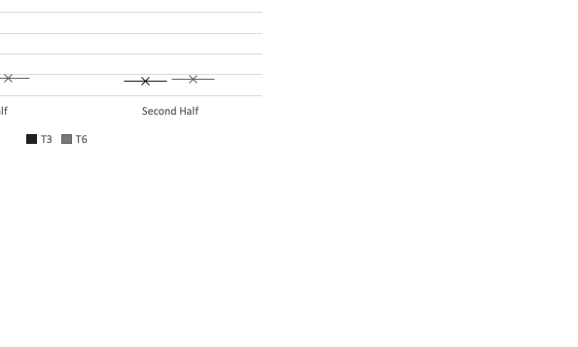
Results and Analysis
jyun (怨=T3 願=T6)
Seconds (Normalised) | Character | Mean F0 (Hz) | Seconds (Normalised) | Character | Mean F0 (Hz)
406 | 怨 | 260.84 | 1016 | 願 | 194.14
410 | 怨 | 210.22 | 1025 | 願 | 196.66
437 | 怨 | 178.04 | 1110 | 願 | 215.26
1449 | 怨 | 246.51 | 1441 | 願 | 195.25
1452 | 怨 | 192.04 | 1442 | 願 | 192.27
1472 | 怨 | 198.40 | 1446 | 願 | 201.92
1509 | 怨 | 202.28 | 1450 | 願 | 192.09
1521 | 怨 | 201.10 | 1460 | 願 | 189.69
 |  |  | 1471 | 願 | 202.80
 |  |  | 1505 | 願 | 192.27
 |  |  | 1507 | 願 | 199.86
 |  |  | 1516 | 願 | 216.53
 |  |  | 1520 | 願 | 199.52
Notes:
Sam: in this task, paticipants will be in separate rooms that have unique information. They'll only be able to solve the puzzles by collaborating. Adaptations will be elicited through merger nonmerger interactions, and through the reversibility of a tone merger
Description of the tasks
Place participants in separate rooms inside video game.
Each of the two rooms have objects or information that are unique to that room specifically.
Participants escape their rooms by sharing information and solving the puzzle presented to them. In this way, only through collaboration will the puzzle be solved.
Adaptation will be elicited/promoted through:
Nature of Tone-Mergers in Cantonese
Merger vs non-merger interactions
Reversibility of a tone-merger as demonstrated by Lin et al previously
The ability to see interlocutor by having screen-off time.

Slide 48
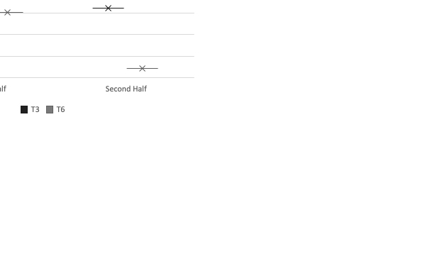
Results and Analysis
jan (印=T3 孕=T6)
Seconds (Normalised) | Character | Mean F0 (Hz) | Seconds (Normalised) | Character | Mean F0 (Hz)
192 | 印 | 215.14 | 189 | 孕 | 201.01
196 | 印 | 205.19 | 192 | 孕 | 181.91
196 | 印 | 200.33 | 323 | 孕 | 240.72
235 | 印 | 191.98 | 328 | 孕 | 187.35
290 | 印 | 198.86 | 380 | 孕 | 187.86
1348 | 印 | 220.98 | 422 | 孕 | 194.97
1602 | 印 | 188.22 | 1598 | 孕 | 207.27
1612 | 印 | 190.85 | 1601 | 孕 | 200.28
1620 | 印 | 201.46 | 1607 | 孕 | 184.68
1633 | 印 | 224.08 | 1608 | 孕 | 178.23
 |  |  | 1611 | 孕 | 175.85
 |  |  | 1613 | 孕 | 196.08
 |  |  | 1621 | 孕 | 177.72
 |  |  | 1634 | 孕 | 187.39
 |  |  | 1635 | 孕 | 196.12
 |  |  | 1643 | 孕 | 188.60
Notes:
Sam: in this task, paticipants will be in separate rooms that have unique information. They'll only be able to solve the puzzles by collaborating. Adaptations will be elicited through merger nonmerger interactions, and through the reversibility of a tone merger
Description of the tasks
Place participants in separate rooms inside video game.
Each of the two rooms have objects or information that are unique to that room specifically.
Participants escape their rooms by sharing information and solving the puzzle presented to them. In this way, only through collaboration will the puzzle be solved.
Adaptation will be elicited/promoted through:
Nature of Tone-Mergers in Cantonese
Merger vs non-merger interactions
Reversibility of a tone-merger as demonstrated by Lin et al previously
The ability to see interlocutor by having screen-off time.

Slide 49
Results and Analysis
Notes:
Sam: in this task, paticipants will be in separate rooms that have unique information. They'll only be able to solve the puzzles by collaborating. Adaptations will be elicited through merger nonmerger interactions, and through the reversibility of a tone merger
Description of the tasks
Place participants in separate rooms inside video game.
Each of the two rooms have objects or information that are unique to that room specifically.
Participants escape their rooms by sharing information and solving the puzzle presented to them. In this way, only through collaboration will the puzzle be solved.
Adaptation will be elicited/promoted through:
Nature of Tone-Mergers in Cantonese
Merger vs non-merger interactions
Reversibility of a tone-merger as demonstrated by Lin et al previously
The ability to see interlocutor by having screen-off time.

Slide 50
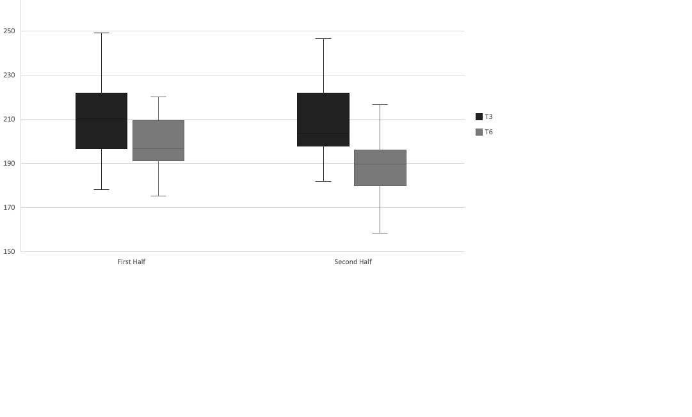
Results and Analysis
Notes:
Sam: in this task, paticipants will be in separate rooms that have unique information. They'll only be able to solve the puzzles by collaborating. Adaptations will be elicited through merger nonmerger interactions, and through the reversibility of a tone merger
Description of the tasks
Place participants in separate rooms inside video game.
Each of the two rooms have objects or information that are unique to that room specifically.
Participants escape their rooms by sharing information and solving the puzzle presented to them. In this way, only through collaboration will the puzzle be solved.
Adaptation will be elicited/promoted through:
Nature of Tone-Mergers in Cantonese
Merger vs non-merger interactions
Reversibility of a tone-merger as demonstrated by Lin et al previously
The ability to see interlocutor by having screen-off time.

Slide 51
Discussion and Conclusion
Trend that the F0 pitch range between T3 and T6 for F22 is being spread further apart throughout the experiment.
Trend of unmerging is not shown in all recorded word pairs, this might be due to a phenomenon called lexical diffusion (Cheung 1986).
Notes:
Sam: in this task, paticipants will be in separate rooms that have unique information. They'll only be able to solve the puzzles by collaborating. Adaptations will be elicited through merger nonmerger interactions, and through the reversibility of a tone merger
Description of the tasks
Place participants in separate rooms inside video game.
Each of the two rooms have objects or information that are unique to that room specifically.
Participants escape their rooms by sharing information and solving the puzzle presented to them. In this way, only through collaboration will the puzzle be solved.
Adaptation will be elicited/promoted through:
Nature of Tone-Mergers in Cantonese
Merger vs non-merger interactions
Reversibility of a tone-merger as demonstrated by Lin et al previously
The ability to see interlocutor by having screen-off time.

Slide 52
Discussion and Conclusion
The downward trend of T3’s F0 throughout the experiment is yet another interesting observation as well
T3 ceiling might hit T1?
Fatigue?
Comfort?
Overall, promising study design
Notes:
Sam: in this task, paticipants will be in separate rooms that have unique information. They'll only be able to solve the puzzles by collaborating. Adaptations will be elicited through merger nonmerger interactions, and through the reversibility of a tone merger
Description of the tasks
Place participants in separate rooms inside video game.
Each of the two rooms have objects or information that are unique to that room specifically.
Participants escape their rooms by sharing information and solving the puzzle presented to them. In this way, only through collaboration will the puzzle be solved.
Adaptation will be elicited/promoted through:
Nature of Tone-Mergers in Cantonese
Merger vs non-merger interactions
Reversibility of a tone-merger as demonstrated by Lin et al previously
The ability to see interlocutor by having screen-off time.

Slide 53
Task Description and Procedure: Number Room
Room A (merger):
Portraits of numbers
Images of body parts in the centre
Room B (non-merger):
Portraits of body parts
Number pad lock box in the centre
Notes:
Ivan
The two participants will have to figure out that:
Each body part in Room B is represented by the number in Room A
The sequence at the centre of Room A is the combination to the lock in Room B

Slide 54
Number Room (cont’d)
The two participants will have to figure out that:
Each body part in Room B is represented by the number in Room A
The sequence at the centre of Room A is the combination to the lock in Room B

Slide 55
Number Room: Room A
Notes:
Ivan
The two participants will have to figure out that:
Each body part in Room B is represented by the number in Room A
The sequence at the centre of Room A is the combination to the lock in Room B

Slide 56
Number Room: Room B
Notes:
Ivan
The two participants will have to figure out that:
Each body part in Room B is represented by the number in Room A
The sequence at the centre of Room A is the combination to the lock in Room B

Slide 57
Simulation for Number Room
NM: My room has a lot of portraits on the wall. There are many illustrations of body parts too - there are eyes, arms, mouths, and noses, that type of stuff. What about you?
M: My side only has some numbers…
NM: Ah, numbers
M: and... numbers and a table with some drawings on it. There are three drawings on it.
NM: Oh, the table has three drawings on it.
M: That's right, three drawings.
NM: My side also has a table... it has a table, and a box. The box has a lock, and it's locked. There are some numbers on the lock as well.
NM:哦我呢度間房呢有好多幅畫喺埲牆上面，吓就有好多身體部位啊，吓啲眼呀手呀眼兒口鼻嗰啲，咁你呢？
M: 我依邊淨係有啲號數咋。
NM: 哦，號數
M: 同埋…號數同埋張枱，仲有啲幅畫，三個幅畫
NM: 哦，張枱有三幅畫
M: 係，係三幅畫
NM: 我呢度呢都有張枱，吓呢度都有張枱，就有個盒，個盒就有個鎖，鎖住左嘅有啲數目字，吓有啲號碼鎖住左嘅

Slide 58
Simulation for Number Room
NM: My room has a lot of portraits on the wall. There are many illustrations of body parts too - there are eyes, arms, mouths, and noses, that type of stuff. What about you?
M: My side only has some numbers…
NM: Ah, numbers
M: and... numbers and a table with some drawings on it. There are three drawings on it.
NM: Oh, the table has three drawings on it.
M: That's right, three drawings.
NM: My side also has a table... it has a table, and a box. The box has a lock, and it's locked. There are some numbers on the lock as well.

Slide 59
Simulation for Number Room
NM: 咁呢，頭先你話呢你張枱有三幅畫呀嘛，係邊三幅啊？
M: 係手臂(sau2 bei6)，手，鼻。
NM: 哦即係第一幅係一個手同埋一個鼻係咪呀?
M: 唔係呀係，唔係一齊㗎。一，第一個係手臂(sau2 bei with ambiguous tone)...
NM: 第一個係...
M: 第二個係手。
NM: 第一個你講緊係咪手臂(sau2 bei3)啊?手臂 (sau2 bei3)?
M: 係手臂(sau2 bei3)，手臂(sau2 bei3)係啱。
NM: 哦姐係手臂(sau2 bei3)，吓第一個手臂(sau2 bei3)，跟住呢？
M: 第二個係手。
NM: 哦第二個係手。咁第三個呢？
M: 第三個係鼻。
NM: 哦即係話第一個係手臂(sau2 bei3)，第二個係手，第三個係鼻，即係話手臂(sau2 bei3)，手，鼻。係咪呀？
M: 係呀係呀，啱呀。
NM: 好
NM: You were talking earlier, you said your table had 3 drawings on it. Which three drawings was it?
M: The drawings were an arm (merged tone), hand, nose.
NM: Oh, so the first drawing is an arm and a nose, is that right?
M: No, that's not right. They're not together. First, The first one is an arm (hyper articulated but still confusable tone)...
NM: The first one is...
M: The second one is a hand.
NM: The first one you're talking about - is it an arm (hyper articulated non-merged tone)? An arm (hyper articulated tone)?
M: Yes, an arm (unmerged tone). An arm (unmerged tone) would be correct.
NM: Oh, so an arm (unmerged tone). The first one is an arm (unmerged tone). What's after that?
M: The second one is a hand.
NM: Oh, the second one is a hand. Then what's the third one?
M: The third one is a nose.
NM: Oh, so you mean that the first one is arm (unmerged tone), the second one is hand, the third one is nose. So, arm (unmerged tone), hand, nose. Is that right?
M: Yes, yes, that's correct.
NM: Okay, good.

Slide 60
Simulation for Number Room
NM: You were talking earlier, you said your table had 3 drawings on it. Which three drawings was it?
M: The drawings were an arm (merged tone), hand, nose.
NM: Oh, so the first drawing is a hand and a nose, is that right?
M: No, that's not right. They're not together. First, The first one is an arm (hyper articulated but still confusable tone)...
NM: The first one is...
M: The second one is a hand.
NM: The first one you're talking about - is it an arm (hyper articulated non-merged tone)? An arm (hyper articulated tone)?
M: Yes, an arm (unmerged tone). An arm (unmerged tone) would be correct.
NM: Oh, so an arm (unmerged tone). The first one is an arm (unmerged tone). What's after that?
M: The second one is a hand.
NM: Oh, the second one is a hand. Then what's the third one?
M: The third one is a nose.
NM: Oh, so you mean that the first one is arm (unmerged tone), the second one is hand, the third one is nose. So, arm (unmerged tone), hand, nose. Is that right?
M: Yes, yes, that's correct.
NM: Okay, good.
Unmerged
arm – Sau2 Bei3
hand – Sau2
nose – Bei6
Merged
arm – Sau2 Bei6
hand – Sau2
nose – Bei6
∴M’s production of arm and hand + nose sound the same to NM.
Notes:
Ivan: The word arm and hand + nose can be produced as the same by a merger.

Slide 61
Simulation for Number Room (cont’d)
NM: You were talking earlier, you said your table had 3 drawings on it. Which three drawings was it?
M: The drawings were an arm (merged tone), hand, nose.
NM: Oh, so the first drawing is an arm and a nose, is that right?
M: No, that's not right. They're not together. First, The first one is an arm (hyper articulated but still confusable tone)...
NM: The first one is...
M: The second one is a hand.
NM: The first one you're talking about - is it an arm (hyper articulated non-merged tone)? An arm (hyper articulated tone)?
M: Yes, an arm (unmerged tone). An arm (unmerged tone) would be correct.
NM: Oh, so an arm (unmerged tone). The first one is an arm (unmerged tone). What's after that?
M: The second one is a hand.
NM: Oh, the second one is a hand. Then what's the third one?
M: The third one is a nose.
NM: Oh, so you mean that the first one is arm (unmerged tone), the second one is hand, the third one is nose. So, arm (unmerged tone), hand, nose. Is that right?
M: Yes, yes, that's correct.
NM: Okay, good.
Notes:
Ivan: Before playing the video, point out what the example merger is!

Slide 62
Task Description and Procedure: Matching Room
Participants must match portrait sequence
Notes:
Sam: Here in the matching room, participants must match the portrait sequence, such that wherever Person A puts the light, Person B must match.

Slide 63
Matching Room Theme: Body Parts

Slide 64
Matching Room Theme: Body Parts

Slide 65
Matching Room Theme: Other Objects
Notes:
Sam: Here, you can see the images a little bit better. Here, basically the bottom two rows are in common, and they have to figure that out

Slide 66
Matching Room Theme: Other Objects
Notes:
Sam

Slide 67
Simulation for Matching Room
NM: 嘩，我呢間房呢有好多幅相好多幅畫喎咁啊又有燈呀有凳啊，呀有隻龜呀，有櫃呀噉樣，噉你呢？ | NM: Wow, my room has a lot of pictures. It has lights, and chairs, a turtle, chests, stuff like that. What about you?
M: 我依邊都有好多相，成十幾張，幾張相都同你一樣幾個添啊。 | M: My side also has a lot of pictures - there at more than 10 pictures. There are some that are the same as you as well.
NM: 哦，好。 | NM: Oh, good.

Slide 68
Simulation for Matching Room
NM: Wow, my room has a lot of pictures. It has lights, and chairs, a turtle, chests, stuff like that. What about you?
M: My side also has a lot of pictures - there at more than 10 pictures. There are some that are the same as you as well.
NM: Oh, good.

Slide 69
Simulation for Matching Room
NM: 好啦，咁我哋而家吓就試吓將個(confusable dang)，將個凳(dang3)，擺落去最右邊先呀。
M: 但係邊張凳(dang3)啊，我依邊有兩張啊。
NM: 係呀，哦，我呢個，咁你有邊兩張啊？
M: 我有張藍色，一張係木嘅。
NM: 哦，哦，我有我有木咋，用木嗰張凳啊擺落去最右邊啊
M: Okay。
NM: 咁隔離呢，又擺多個，擺多個(confusable dang)啊，擺多個燈(dang1)係隔離啊。
M: Okay，淨係有一張，一盞燈(dang1)咋。
NM: 吓？姐係講緊，你講緊你仲有一張凳(dang3)呀？我唔係講凳(dang3)喎，我講緊燈(dang1)喎。
M: 燈(dang1)，燈(dang1)係啱，我淨係有一燈(dang1)啊。
NM: 哦燈(dang1)呀嘛，係咪啊，講嗰個着咗嗰個燈(dang1)係咪啊？
M: 係呀。
NM: 哦，咁呀着咗嗰個燈(dang1)就而家擺喺個凳嘅左邊喇喎。
M: Okay，擺咗喇。
NM: 好。
NM: Okay, great! So now, let's try to take the light (ambiguous tone due to unknown pitch range) - take the chair (unambiguous tone due to both tones being pronounced in the same utteranxce), right, and put it on the right-most side first.
M: But...which chair (unambiguous tone due to use of classifier)? My side has two chairs.
NM: Is that right? Mine... Which two chairs do you have?
M: I have one that's blue, and one that's wooden.
NM: Oh, I only have a wooden one. Use the wooden chair and put it on the right-most side.
M: Okay.
NM: And next to that one, put another... put another light (ambiguous tone)... put another light (unambiguous due to hyper articulation, known pitch range, and both tones being pronounced in the same utterance) beside it .
M: Okay. I only have one (classifier for chair), one (classifier for light) light.
NM: What? You mean you have another chair? I'm not talking about chairs, I'm talking about lights (establishing common ground, possibly a common pitch range).
M: Lights are right, it's just that I just have one.
NM: Oh, lights, right? (common ground reached, word no longer ambiguous) Are you talking about the light that's on?
M: That's right.
NM: Okay, then take that light that's on, and now let's put it to the left of the chair.
M: Okay, I've placed it.
NM: Okay, good.

Slide 70
Simulation for Matching Room
NM: Okay, great! So now, let's try to take the light (ambiguous tone due to unknown pitch range) - take the chair (unambiguous tone due to both tones being pronounced in the same utterance), right, and put it on the right-most side first.
M: But...which chair (unambiguous tone due to use of classifier)? My side has two chairs.
NM: Is that right? Mine... Which two chairs do you have?
M: I have one that's blue, and one that's wooden.
NM: Oh, I only have a wooden one. Use the wooden chair and put it on the right-most side.
M: Okay.
NM: And next to that one, put another... put another light (ambiguous tone)... put another light (unambiguous due to hyper articulation, known pitch range, and both tones being pronounced in the same utterance) beside it .
M: Okay. I only have one (classifier for chair), one (classifier for light) light.
NM: What? You mean you have another chair? I'm not talking about chairs, I'm talking about lights (establishing common ground, possibly a common pitch range).
M: Lights are right, it's just that I just have one.
NM: Oh, lights, right? (common ground reached, word no longer ambiguous) Are you talking about the light that's on?
M: That's right.
NM: Okay, then take that light that's on, and now let's put it to the left of the chair.
M: Okay, I've placed it.
NM: Okay, good.
Notes:
Before playing the video, point out the merging example!

Slide 71
Simulation for Matching Room
Due to an unfamiliar pitch range, NM’s “light” (dang1) might sound like M’s chair (dang3)
Notes:
Ivan: Before playing the video, point out the merging example!

Slide 72
Simulation for Matching Room
After adaptation, the pitch range is established and converged, ambiguity is gone.
Notes:
Ivan: Before playing the video, point out the merging example!

Slide 73
Simulation for Matching Room
NM: Okay, great! So now, let's try to take the light (ambiguous tone due to unknown pitch range) - take the chair (unambiguous tone due to both tones being pronounced in the same utterance), right, and put it on the right-most side first.
M: But...which chair (unambiguous tone due to use of classifier)? My side has two chairs.
NM: Is that right? Mine... Which two chairs do you have?
M: I have one that's blue, and one that's wooden.
NM: Oh, I only have a wooden one. Use the wooden chair and put it on the right-most side.
M: Okay.
NM: And next to that one, put another... put another light (ambiguous tone)... put another light (unambiguous due to hyper articulation, known pitch range, and both tones being pronounced in the same utterance) beside it .
M: Okay. I only have one (classifier for chair), one (classifier for light) light.
NM: What? You mean you have another chair? I'm not talking about chairs, I'm talking about lights (establishing common ground, possibly a common pitch range).
M: Lights are right, it's just that I just have one.
NM: Oh, lights, right? (common ground reached, word no longer ambiguous) Are you talking about the light that's on?
M: That's right.
NM: Okay, then take that light that's on, and now let's put it to the left of the chair.
M: Okay, I've placed it.
NM: Okay, good.
Notes:
Ivan: Before playing the video, point out the merging example!

Slide 74
Yes, we have a playable demo
Notes:
Ivan

Slide 75
Summary
Novel solution aided by a video game
Tasks allow for unscripted, natural-like interactions between two interlocutors
However, lack of script may allow participants to go off-topic
Can help determine if a non-imitation task can also reverse a tone merger
Future research includes:
Testing if a noisy environment would further promote adaptation
If a reversed merged tone would linger, and if so, for how long post-task
Notes:
Sam:
In summary, our study is proposing a novel solution where tasks allow for unscripted interactions. We think it can help determine if a non-imitation task can reverse a tone-merger.
Future research could investigate noisy environments or long-term changes

Slide 76
Acknowledgements
We would like to thank the members and collaborators of the Language and Brain Lab at Simon Fraser University, including Dr. Yue Wang, Dr. Dawn Behne, Jetic Gu, Elise McClay, Janitta Wong, Samantha Gryz, and Sylvia Cho for their guidance, critical and constructive comments, and suggestions throughout.
Notes:
Sam: we'd like to thank the members of the language andn brain lab at sfu, in particular dr yue wang and dr dawn behne, for their guidance etc throughout

Slide 77
References
Baker, R. & Hazan, V. (2011). DiapixUK: Task materials for the elicitation of multiple spontaneous speech dialogs. Behavior Research Methods 43(3), 761-770. https://doi.org/10.3758/s13428-011-0075-y
Dias, J. W., & Rosenblum, L. D. (2011). Visual influences on interactive speech alignment. Perception (London), 40(12), 1457–1466. https://doi.org/10.1068/p7071
Fung, R. S. Y., & Lee, C. K. C. (2019). Tone mergers in Hong Kong Cantonese: An asymmetry of production and perception. The Journal of the Acoustical Society of America, 146(5), EL424–EL430. https://doi.org/10.1121/1.5133661
Lee, Y., Gordon Danner, S., Parrell, B., Lee, S., Goldstein, L., & Byrd, D. (2018). Articulatory, acoustic, and prosodic accommodation in a cooperative maze navigation task. PloS One, 13(8), e0201444–e0201444. https://doi.org/10.1371/journal.pone.0201444
Levitan, R., & Hirschberg, J. (2011, ). Measuring acoustic-prosodic entrainment with respect to multiple levels and dimensions. Proc. Interspeech 2011, 3081-3084. https://doi.org/10.21437/Interspeech.2011-771
Lin, Y., Yao, Y., & Luo, J. (2021). Phonetic accommodation of tone: Reversing a tone merger-in-progress via imitation. Journal of Phonetics, 87, 101060. https://doi.org/10.1016/j.wocn.2021.101060
Mok, P. P. K., Zuo, D., & Wong, P. W. Y. (2013). Production and perception of a sound change in progress: Tone merging in Hong Kong Cantonese. Language Variation and Change, 25(3), 341–370. https://doi.org/10.1017/S0954394513000161
Pardo, J. S. (2006). On phonetic convergence during conversational interaction. The Journal of the Acoustical Society of America, 119(4), 2382–2393. https://doi.org/10.1121/1.2178720
Pardo, J. S., Urmanche, A., Wilman, S., & Wiener, J. (2017). Phonetic convergence across multiple measures and model talkers. Attention, Perception & Psychophysics, 79(2), 637–659. https://doi.org/10.3758/s13414-016-1226-0
Pine Studio. (2021). Escape Simulator (Version 1.0.24338r) [Video Game]. Samobor, Croatia. https://pinestudio.com/games/escape-simulator/
Soo, R., and Babel, M. (2020, July 6). Lexical competition affects Cantonese tone mergers in word recognition [Poster]. 17th Conference of the Association for Laboratory Phonology (LabPhon17), University of British Columbia, Vancouver, British Columbia, Canada. https://labphon.org/sites/default/files/previous_conferences/LP17/abstracts/LabPhon_17_paper_242.pdf

Slide 78
Thank you! Questions?
Notes:
Ivan

